Slide 1
Speaker Notes
This deck is part of “App Camp in a Box”, a set of material to accompany the App Camp labs in an in-person workshop.
Instructors are strongly encouraged to watch the App Camp videos and complete the labs before delivering or proctoring App Camp! https://aka.ms/app-camp
Instruct your students to do the labs at that same location – https://aka.ms/app-camp
⬇️ Don’t forget to check the speaker notes! ⬇️

Slide 2


Welcome to App Camp
Notes:
Welcome the students to Microsoft Teams App Camp! Students will learn how to extend a web application to be a full-featured Microsoft Teams app, and how to sell it in the Microsoft Teams app store.

Slide 3
Coach #1
Photo
Coach #2
Photo
Coach #1 job’s title
Coach #2 job’s title
Notes:
Please edit this slide and introduce the speaker(s)!

Slide 4



What you’ll
learn today
Modernize your webapp as a Teams tab
Make your users’ life simpler with SSO
Apply MS Teams styling & themes
Let’s take a look…
Make you app available in teams, groups & meetings
Share & access your app via deeplinks
Add a dialog to get user inputs
Query your app’s data in the flow of a conversation

Slide 5
Please update for your event
Step | Intro | Hands-on | Total | Cumulated
Tools installation / subscribe to O365 Dev program |  |  | 30-45 min
Welcome |  |  | 20 min | 20 min
Lab A01: Start with Azure AD | Fully guided | 30 min | 30 min | 50 min
Lab A02: Create a Teams app with Azure AD Single Sign-On | 15 min | 20 min | 35 min | 1h25
Lab A03: Teams styling and themes | 10 min | 10 min | 20 min | 1h45
BREAK |  |  | 15 min | 2h
Add a Configurable Tab | 10 min | 15 min | 25 min | 2h25
Add a Deep link to a personal Tab | 10 min | 10 min | 20 min | 2h45
Add a Dialog | 10 min | 10 min | 20 min | 3h05
Add a Meeting app | 10 min | 15 min | 25 min | 3h30
BREAK |  |  | 15 min | 3h45
Add a message Extension | 20 min | 40 min | 60 min | 4h45
Wrap-up |  |  | 5 min | 4h50
 | 105 min | 150 min | 290 min | 4h50
Notes:
These times are approximate. Feel free to structure the lab time as you wish!

Slide 6




App Camp Labs
Core Lab (path A)
App setup
Add tab with SSO
Add look and feel
Core Lab (path B)
App setup
Add tab with SSO
Add look and feel
App setup no AAD
Migrate a non-Azure AD Web App to Teams
Migrate an Azure AD Web App to Teams
start
https://aka.ms/app-camp
Personal tab w/Azure AD SSO
Core Teams Application
Extend capabilities
Configurable tab
Messaging Extension w/Adaptive Cards
Deep links
Task modules
Monetization
Tab in Meeting
Notes:
Most students should begin by completing the “A Path” (labs A-01 – A-03).
There is an alternate “B Path” (labs B-01 – B-04).
USE THE “A” PATH IF YOUR STUDENTS:
- already use Azure AD for authentication OR
- do not authenticate users OR
- are building new applications
USE THE “B” PATH IF YOUR STUDENTS: - want to build a Teams app based on an existing app that uses a non-Azure AD identity system such as Auth0, Identity Server, Okta, Ping Federate, or Azure AD B2C, or a bespoke identity system such as ASP.NET SQL based authentication
The solution files for the extended labs are all built on the A-03 solution; they have been tested building on B-04 but students will need to understand the code and adapt the instructions in order to make this work.
The extended labs can be done in any order, although not all the permutations have been tested. The /src/extend-with-capabilities/All folder contains the result of completing all of the extended labs and is useful for demonstration purposes.

Slide 7
Lab Structure
Core Lab (path A)
App setup
Add tab with SSO
Add look and feel
Migrate an Azure AD Web App to Teams
start
Personal tab with
Azure AD SSO
Core Teams Application
Configurable
tab
Deeplinks
Dialog
Meeting App
Message Extension w/Adaptive Cards
Extend capabilities
Notes:
Students should begin by completing the “A Path” (labs A-01 – A-03). If they want to try the alternative lab which shows how to link another identity system to Azure AD, they could complete the “B Path” but the solution files for the extended labs won’t match.
Once that’s done, students can pursue the extended labs in any order.

Slide 8






Northwind Orders application
https://northwind-traders.com
Northwind Trader is a trading company that manages orders, products, customers, suppliers and many other aspects of a smal business. They developed an application from the good all times of Microsoft Access - Employees are used to this app with it's unique 90's and greyish UI that contains all their product inventory and order book. Since this old times Northwind Traders has since adopted cloud technologies like Microsoft Teams as their collaboration platform. They want to refresh their application and bring it into Teams for greater employee engagement and efficiency in how users consume and share it's content.
You'll help Northwind trader to achieve all of that!

Slide 9
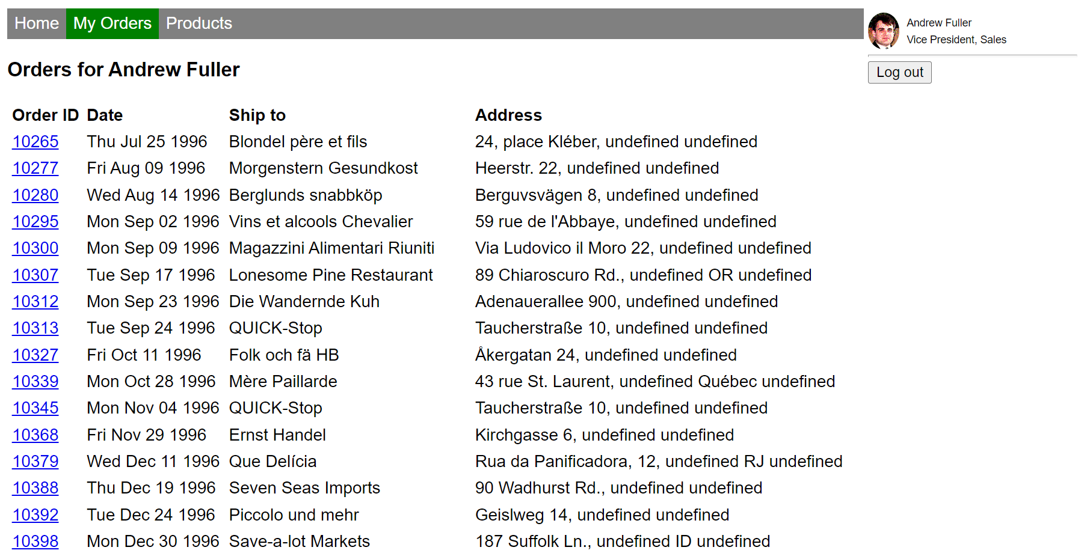
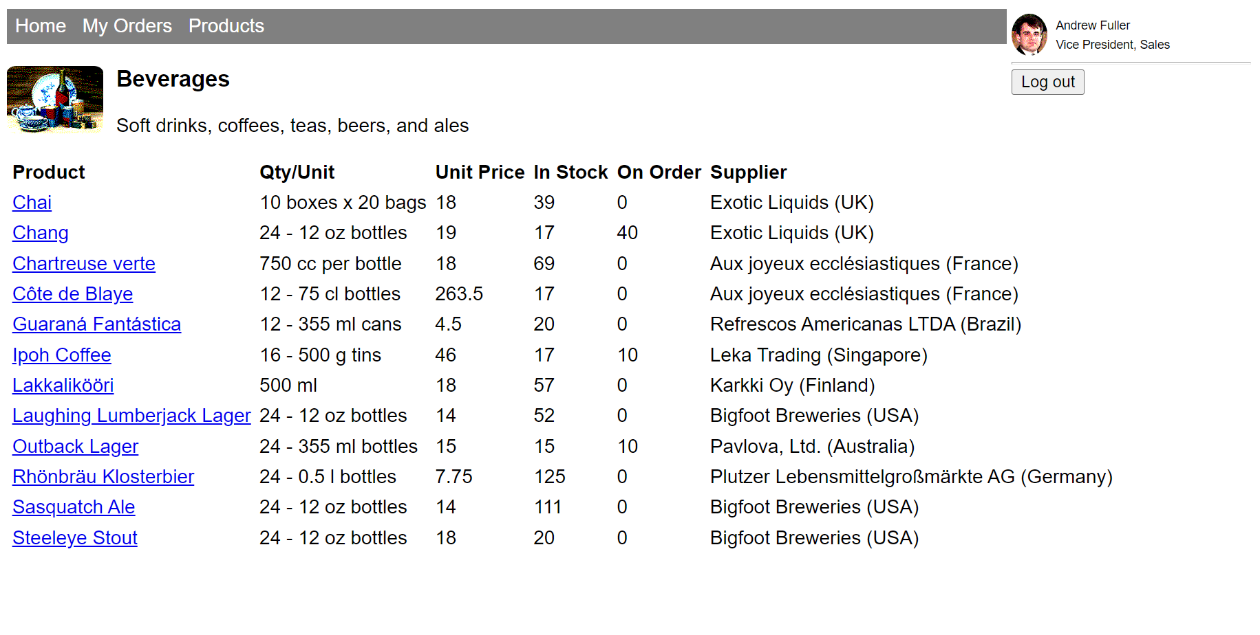
Northwind Orders application
Let’s take a look…
https://northwind-traders.com/pages/xxx.html
Notes:
IN TEAMS APP CAMP, YOU'LL PORT THE NORTHWIND ORDERS APPLICATION, WHICH IS A SIMPLE SOFTWARE-AS-A-SERVICE APP, TO BECOME A MICROSOFT TEAMS APPLICATION.

Slide 10
Technical Briefing: How Teams applications work

Slide 11










Teams apps add capabilities to Microsoft Teams
Teams apps run anywhere but Teams
you supply web pages, web services, and make API calls
run anywhere on the Internet
use any application stack
Tabs
Bots
Surface rich content as well as SharePoint Framework* based solutions
Help users get tasks done in conversations
Messaging Extensions
Connectors
App Package defines the app
Allow users to query and share rich cards in conversations
Post rich updates to channels
manifest.json
.zip
Dialogs
Adaptive Cards
Interact with users individually, even in a group setting (formerly called “Task Modules”)
Interactive content in chats and dialogs
Upload for yourself or a Team you own
Publish to enterprise app catalog of
Publish in the Teams store
YOU CAN
Notes:
The left side of the slide shows the Teams app “capabilities”.
Teams apps don’t actually run in Teams! They just expose web pages and web services, which could be anywhere on the Internet.
Tabs, as well as cofnguration pages and dialogs, are just web pages
Bots and Messaging Extensions are web services that communicate with the Azure Bot Service
Dialogs are invoked using an API
Adaptive cards can be used in Bots, Messaging extensions, and Dialogs, and are just JSON structures
All standard stuff – though Microsoft SDK’s make it easier.
A Teams app package is a zip file containing a file called manifest.json, plus a couple of icons. The manifest.json file contains the locations of the web pages, the Bot ID for bots and messaging extensions, and other information Teams needs to cleverly stitch your application into the Teams user interface.

Slide 12
Teams application scopes
Teams Scope - your app in a Teams channel
Group Conversations/Meetings – your app in a group or 1:1 chat
Personal Scope – your app accessed by individual users
Notes:
Teams apps can run in 3 application scopes.
Teams channels are part of Teams, which have a specific membership. Your app is interacting with the members of the Team.
Group conversations – which include meetings – have an ad-hoc membership but still your app is interacting with multiple users.
Personal scope apps are selected in the left navigation of Teams. This is where your app can work 1:1 with users; this is a good place to provide per-user summaries or other information that will be different for each user/

Slide 13
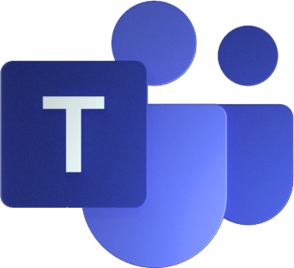
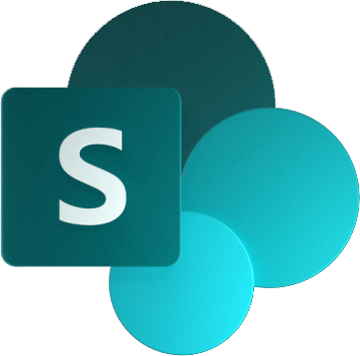

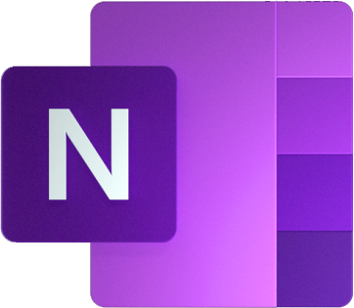




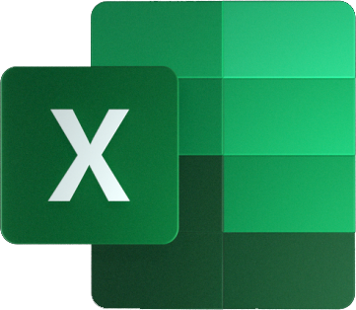
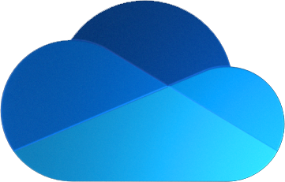
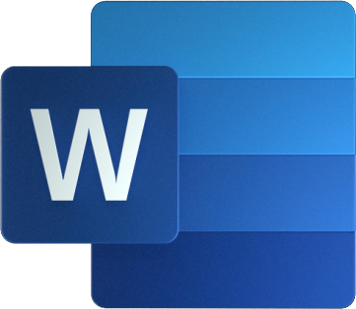
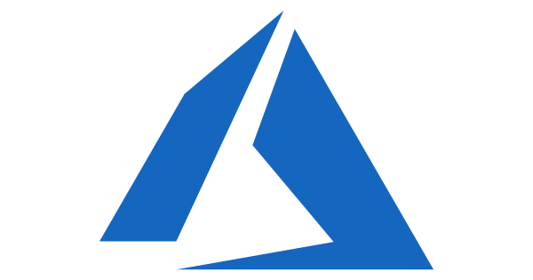

Teams Architecture
Microsoft Teams Clients
Electron (Windows, MacOS, Linux)
Web
iOS
Android
Teams Services
Files, Web pages Compliant file storage
Office
OneNote
Planner
Stream
To Do
Calendar
Compliant message storage
Microsoft 365 Services
Microsoft Azure
Azure Active Directory
Notes:
Teams clients – which include a desktop app, web app, and mobile app – run over not just Teams back-end services but also services all across Microsoft 365. Teams stitches them all together into a unified user experience.
Microsoft Azure AD is the identity system that’s common to all these services; without a common identity system, it would be difficult to provide a seamless and secure user experience.

Slide 14




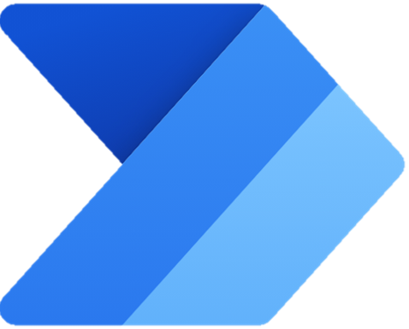
Teams Application Architecture
Microsoft Teams Clients
Electron (Windows, MacOS, Linux)
Web
iOS
Android
Your Application
Tabs
Bots
Messaging Extensions
Connectors
Task Modules etc.
manifest.json
Teams Services
Files, Web pages Compliant file storage
Office
OneNote
Planner
Stream
To Do
Calendar
Compliant message storage
Microsoft 365 Services
Microsoft Azure
Azure Active Directory
Notes:
Your app doesn’t run in Teams; it just appears in the Teams UI.
(CLICK to show the manifest file which tells Teams how to display your app)

Slide 15

Teams Application Architecture
Microsoft Teams Clients
Electron (Windows, MacOS, Linux)
Web
iOS
Android
Your Application
Tabs
Bots
Messaging Extensions
Connectors
Task Modules etc.
manifest.json
Tabs: Teams JS SDK
Microsoft Graph
Adaptive Card actions
Bots, Msg Ext: Azure Bot SDK
Teams Services
Files, Web pages Compliant file storage
Office
OneNote
Planner
Stream
To Do
Calendar
Compliant message storage
Microsoft 365 Services
Microsoft Azure
Azure Active Directory
Notes:
Your app can also make use of all those underlying services!
The API that makes all that data available is called the Microsoft Graph.

Slide 16

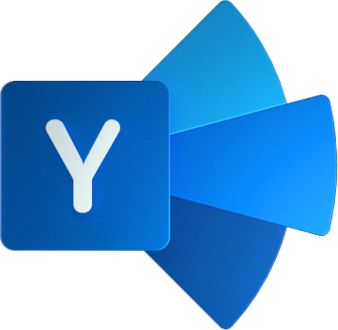


Anatomy of a Teams App
Azure AD
REST API
Teams Application
Microsoft 365 Data
Your app’s web pages in the Teams client
Teams JavaScript SDK
Microsoft Graph API
REST API
Web content; REST API
Your app’s web servers(s)
Azure Bot Framework
Microsoft Graph SDK
Bot Builder SDK
Message Extensions
Adaptive Card actions
Proactive Bots
Conversational bots
REST API
manifest.json
Notes:
A typical Teams app is served up by an ordinary web server, which serves up web pages to be displayed in tabs, dialogs, and configuration pages.
In addition, it typically provides a REST interface for use by the client apps. The client-side code authenticates itself to the app’s server using an Azure AD access token provided by the Teams JavaScript SDK; the web server validates this token using an Azure AD library.
When the app needs access to content in Teams or other parts of Microsoft 365, it uses the Microsoft Graph API. To call the Graph, it needs an Azure AD access token; the app uses the Oauth 2.0 On Behalf Of flow to swap the incoming access token for a new one that targets the Microsoft Graph.
This works well for many things, but sometimes Teams needs to provide real-time updates to the app, such as when a message extension is clicked or a conversational bot receives a message. This is provided by the Azure Bot Framework, which is well-suited to provide secure real-time messaging between the app and Microsoft Teams.

Slide 17







Microsoft 365 Groups
Microsoft Graph API
Microsoft 365 Groups
Every Team is based on a Microsoft 365 Group
Every Microsoft 365 Group has:
Owners
Members
“Stuff” – SharePoint Team Site, Shared calendar and mailbox, Shared OneNote, Planner (more optional)
Great resources from
http://bit.ly/O365GroupGuide
http://bit.ly/O365PeriodicTable
This Photo by Unknown Author is licensed under CC BY-SA
Notes:
Microsoft Teams are based on an older technology called Office 365 Groups (now Microsoft 365 Groups).
This is a membership service for M365 teamwork apps based on Azure AD.
Each Group has a set of owners (the Team owners) and members (the Team members).
Each Group also has other Microsoft 365 resources connected to it, including a SharePoint Team site (site collection), a shared Exchange calendar and mailbox, a shared OneNote, and a Planner plan. Permission to access these resources is based on the owners and members of the Group.
So in the Teams scope, your app can depend on these resources; for example there will always be a SharePoint site and users will have permission to access it.
You may encounter this when using the Graph API. The Team ID is the same as the Office 365 ID.

Slide 18
Where is the data?
Access the data using the Microsoft Graph SDK
Entity
Short term Storage
Long-term Storage
Message
Cosmos DB
Ingested to Exchange to enable compliance
Image
Media service on Azure (using Blob storage)
Ingested to Exchange to enable compliance
Files
Team files → SharePoint
Chat files → OneDrive for Business
Voicemail
Individual mailbox in Exchange
Recording
Media service on Azure (using Blob storage) (<24 hours)
Encoded to Stream (SharePoint)
Calendar meeting
Individual mailbox in Exchange
Contacts
Exchange
Telemetry
Microsoft Data warehouse (No customer content)
Notes:
Students may ask where all this data is stored; this slide shows the answer.
Some items are migrated for long-term storage in Exchange or SharePoint, which have advanced compliance features like data retention and e-Discovery.
Applications should not use the locations shown in this slide! They should use the Microsoft Graph. The details of data storage may change and Graph will continue to work.

Slide 19
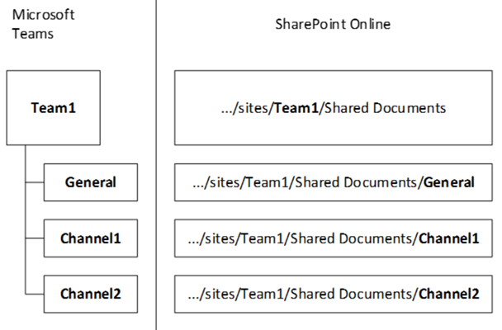
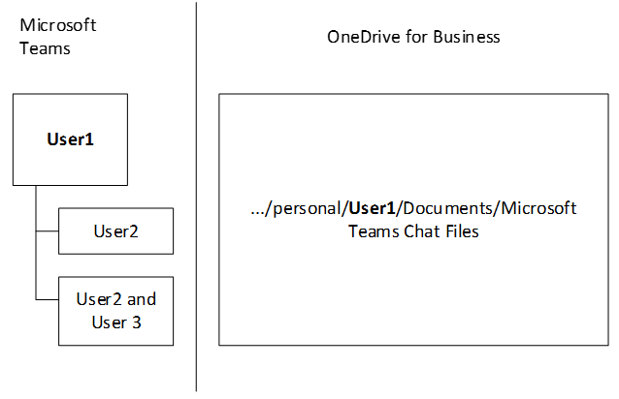
File Structure
Files in Teams/Channels
Modern Team site is created as part of creating Office 365 group
Document library has a folder for each channel
By default, all channels/folders inherit the permissions of the underlying O365 Group You can change them in SharePoint and Teams will respect them
Files in 1:1 or Group Chat
Files are in a folder in the sender’s OneDrive called “Microsoft Teams Chat Files”
Each file has unique permissions of the people in the chat
Notes:
If you want to access the files Teams, they are stored in SharePoint and OneDrive.
(SharePoint and OneDrive share the same storage back-end and Graph calls)
Files in Teams are stored in the SharePoint site associated with the Team’s underlying Microsoft 365 Group. There is a folder for each channel (except for private channels, which get their own SharePoint site).
Files in group or 1:1 conversations are stored in the sender’s OneDrive in a folder called “Microsoft Teams Chat Files” and the permissions are altered to allow the people in the conversation to have access.

Slide 20
Next, let’s learn about Azure AD
Notes:
That’s the background now it’s time for labs!

